Slide 1
GROUP D
BUSAKA PATRICK
JOSHUA AKWDA
MARSHAL MOSES
OSI ODIODO
MBONU CHINEDU

Slide 2
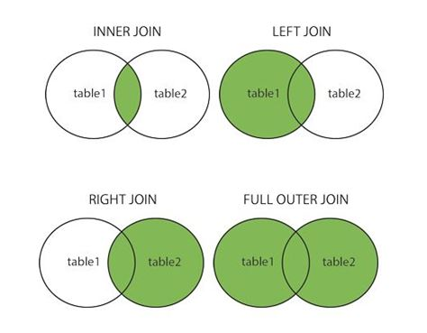
INTRODUCTION TO SQL JOINS SQL Joins allow you to collate two or more (sometimes just one table) tables using common identifiers.
TYPES
Inner Join
Left Join
Right Join
Full Join
Cross Join

Slide 3
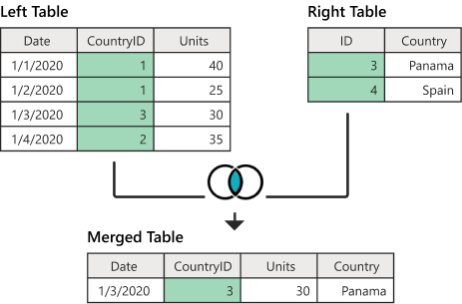
INNER JOIN Inner Join only includes records in which the key is in both tables. Inner Join is used when you want to return records having pair on both sides.

Slide 4
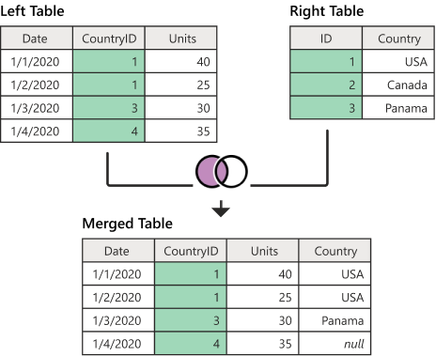
LEFT JOIN
Left Join notes those records in the left table that do not have a match on the key field in the right table.
Left Join is used when you need all records from the “left” table, no matter if they have pair in the “right” table or not.

Slide 5
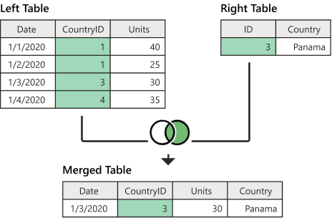
RIGHT JOIN
Right Join notes those records in the left table that do not have a match on the key field in the left table.
Right Join is used when you need all records from the “right” table, no matter if they have pair in the “left” table or not.

Slide 6
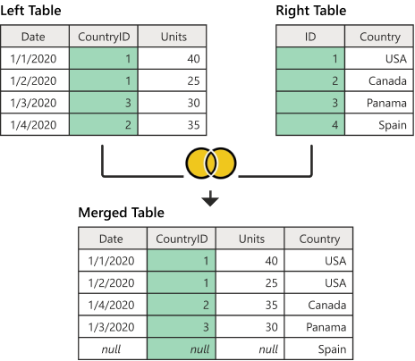
FULL JOIN A Full Join combines a Left Join and a Right Join. It brings all records from both the left and the right table and keep track of the missing values accordingly.

Slide 7
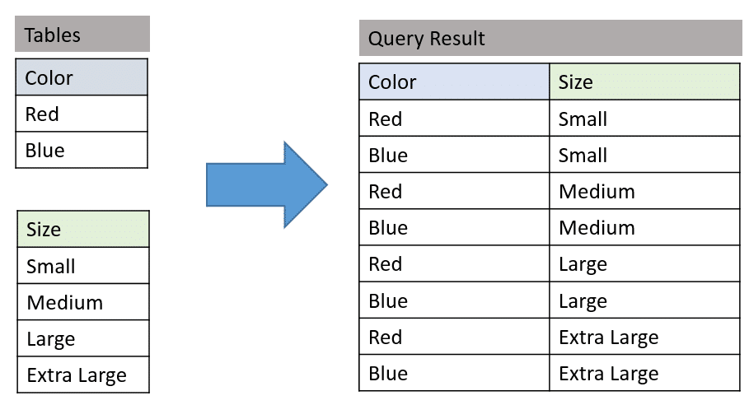
CROSS JOIN Cross Joins creates all possible combination of two tables. If you are trying to apply all rows from one table to all rows of another table

Slide 8
SUMMARY
Inner Join is used when you want to return records having pair on both sides.
Left Join is used when you need all records from the left table, no matter if they have pair in the “right” table or not.
Right Join is used when you need all records from the right table, no matter if they have pair in the “left” table or not.
The full join useful when you want all rows combined from your tables.
A Cross Join is useful when you are trying to apply all rows from one table to all rows of another table.

Slide 9
CONCLUSION
Thank you for your time and patience. We believe this presentation was done in a simple, sequential, and logical manner. We hope that it gives you a better understanding of JOINS and helps you write more efficient SQL queries.

